Slide 1
Android Application Development (I)
Practice – Project Breakdown (Process & Thread)

Slide 2
Agenda
Self Introduction
Intellectual Property Rights
Project Introduction
Android Introduction
Get Started with Android
Requirement
Object-Oriented Analysis and Design
Scrum
Project Breakdown
Acceptance Test Criteria
Publish Application
Notes:
Object-oriented analysis and design (OOAD) is a software engineering approach that models a system as a group of interacting objects. Each object represents some entity of interest in the system being modeled, and is characterised by its class, its state (data elements), and its behavior. Various models can be created to show the static structure, dynamic behavior, and run-time deployment of these collaborating objects. There are a number of different notations for representing these models, such as the Unified Modeling Language (UML).
Object-oriented analysis (OOA) applies object-modeling techniques to analyze the functional requirements for a system. Object-oriented design (OOD) elaborates the analysis models to produce implementation specifications. OOA focuses on what the system does, OOD on how the system does it.
Ref: http://en.wikipedia.org/wiki/Object-oriented_analysis_and_design
IFRS - International Financial Reporting Standards
GAAP - Generally Accepted Accounting Principles

Slide 3
Processes and Threads Overview
When an application starts, the Android system starts a new Linux process for all components of the application with a single thread (Main) of execution.

Slide 4
Processes and Threads Process
All components of the same application run in the same process by default
Control which process a certain component belongs to with attribute android: process
Activity, Service, Receiver and Provider
Application

Slide 5
Processes and Threads Process Lifecycle
To determine which processes to keep and which to
kill, the system places each process into an
"importance hierarchy“.
Foreground Process (user interact with)
Visible Process (activity behind a dialog)
Service Process (playing music in background)
Background Process (activity is in state onStop)
Empty Process (don’t hold any active components)

Slide 6
Processes and Threads Process Ranking Strategy
Android ranks a process at the highest level it can
Q: A service in background and A visible activity
A: Visible process, but NOT service process
Q: A service user interact with and A visible activity
A: Foreground process, but NOT visible process
Process's ranking might be increased because other processes are dependent on it
Typical usage: uploading a picture to a web site
Q: why we need to start service for that
A: Using a service guarantees that the operation will have at least "service process" priority, regardless of what happens to the activity.

Slide 7
Processes and Threads Thread
Dispatching events to the appropriate user interface widgets, including drawing events
Interact with components from Android UI tookit (components from android.widget and android.view package)
Q: What will happened if everything is handling in the UI thread, performing long operations such as network access or database queries will block the whole UI.
A: When the thread is blocked, no events can be dispatched, including drawing events.
A: If more than 5 seconds, ANR application not responding will be presented to the user
Thus, there are simply two rules to Android's single thread model:
Do not block the UI thread
Do not access the Android UI toolkit from outside the UI thread

Slide 8
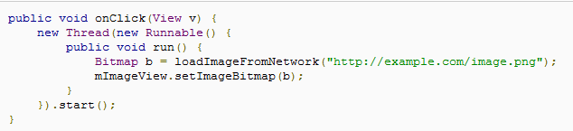
Processes and Threads Worker Thread
If you have operations to perform that are not instantaneous, you should make sure to do them in separate threads ("background" or "worker" threads).
What’s the problem?
It violates the second rule of the single-threaded model: do not access the Android UI toolkit from outside the UI thread

Slide 9
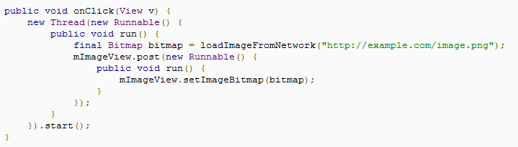
Processes and Threads Worker Thread Cont.
The way to fix the problem
Activity.runOnUiThread(Runnable)
View.post(Runnable)
View.postDelayed(Runnable, long)
Thread-safe. The network operation is done from a separate thread while the ImageView is manipulated from the UI thread.

Slide 10
Processes and Threads Interprocess Communication
Android offers a mechanism for interprocess communication (IPC) using remote procedure calls (RPCs)
In which a method is called by an activity or other application component, but executed remotely (in another process), with any result returned back to the caller
A bound service offers a client-server interface that allows components to interact with the service

Slide 11
Processes and Threads Interprocess Communication Cont.
Client
Server
bindService
IBinder
onBind
unbindService

Slide 12
Project Breakdown (SoundRecorder) Requirement - Start/Stop Recording
Basic Requirement (Mandatory)
Define data structure for the audio information
Implement the callback for button start/stop to record audio
Implement the callback for button to launch playlist activity
Update recording time timely in text view
Advanced Requirement (Optional)
Implement the callback for button to set the preference (time limitation and audio file format)
Update audio spectrum according to the volume of voice in customized view

Slide 13
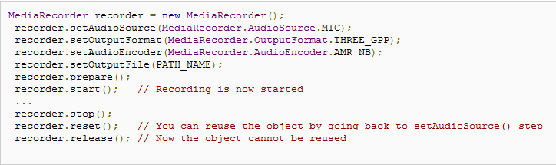
Project Breakdown (SoundRecorder) Hints – MediaRecorder (Start/Stop)
Used to record audio. The recording control is based on a simple state machine [Ref]
Note: Design a class to encapsulate all operations of MediaRecorder to ease coding

Slide 14
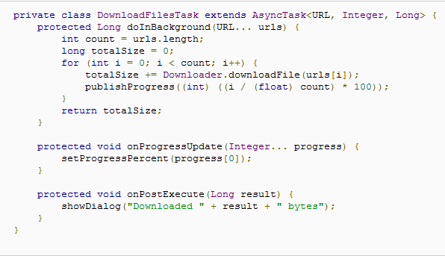
Project Breakdown (SoundRecorder) Hints – AsyncTask (Thread-safe)
It allows to perform background operations and publish results on the UI thread without having to manipulate threads and/or handlers [Ref]
Start recording in doInBackground
Update UI elements in onPostExecute
Task should be executed when record button is clicked

Slide 15
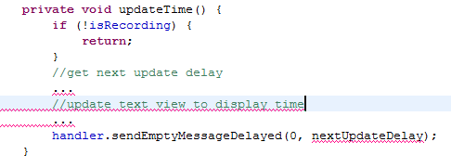
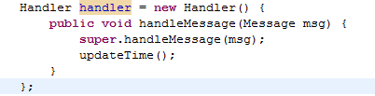
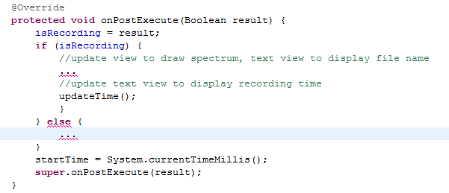
Project Breakdown (SoundRecorder) Hints – Handler (Continuously Update Time)
A handler allows you to send and process Message and Runnable objects associated with a thread's MessageQueue. Each Handler instance is associated with a single thread and that thread's message queue. When you create a new Handler, it is bound to the thread / message queue of the thread that is creating it -- from that point on, it will deliver messages and runnables to that message queue and execute them as they come out of the message queue. [Ref]
3
2
1

Slide 16
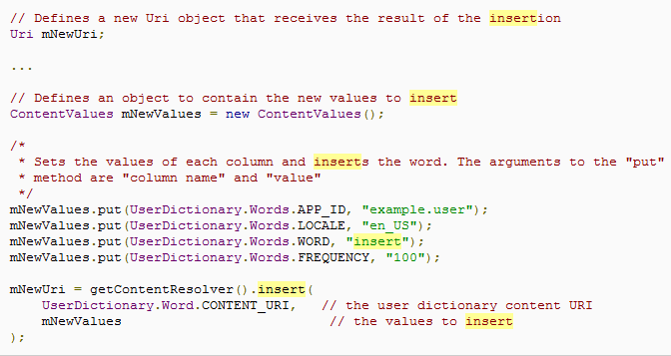
Project Breakdown (SoundRecorder) Hints – ContentResolver (Insert)
To insert data into a provider [Ref]
Refer to MediaStore to get key of content

